Slide 1

CytoAutoCluster: A Semi-Supervised Deep Approach for Cytometry Data Analysis
J.MOHAN KUMARI

Slide 2
Introduction and Background
Objective:
Preprocess and analyze high-dimensional cytometry data
Develop semi-supervised clustering algorithms
Validate against manually gated clusters
Key Insight:
Cytometry data analysis is critical for understanding immune profiles and biomarker discovery.
This project explores semi-supervised clustering algorithms, including techniques like autoencoder-based feature learning, to address these challenges.

Slide 3
Dataset Overview
Characteristic | Details
Cells (n) | 265,627
Markers (p) | 32
Manually Labeled Cells | 39% (104,184 cells)
Clusters (k) | 14
Unlabeled Cells | 61%(161,443 cells)
Table 1:Dataset Details
The dataset, Levine_32dim, is sourced from Levine et al. (2015). It is a benchmark dataset for clustering algorithms and is publicly available on platforms like Cytobank.

Slide 4
Challenges in Cytometry Analysis
High Dimensionality: Complex data with 30+ markers per cell
Noise: Instrument variability and sample inconsistencies
Label Imbalance: Rare cell types are underrepresented
Solution Strategy: Semi-supervised learning, feature extraction, and robust preprocessing.

Slide 5
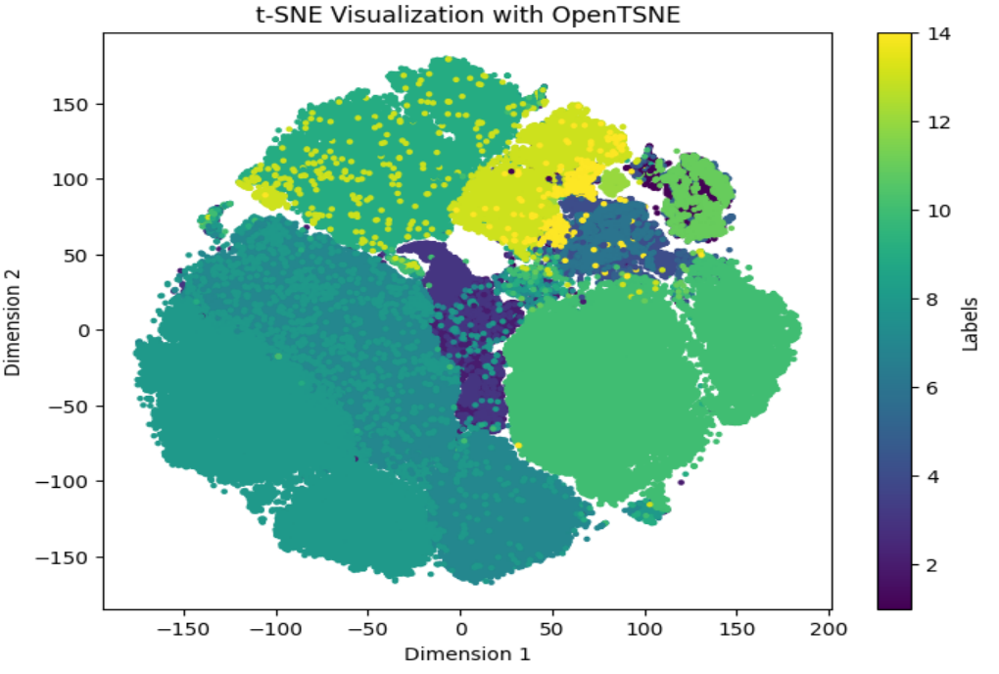
Methodology
Preprocessing:
Data normalization and exploratory analysis
Handling partially labeled datasets
Clustering Techniques:
Autoencoder-based dimensionality reduction
t-SNE visualization for cluster identification
TSNE Before Encoder Implementation

Slide 6
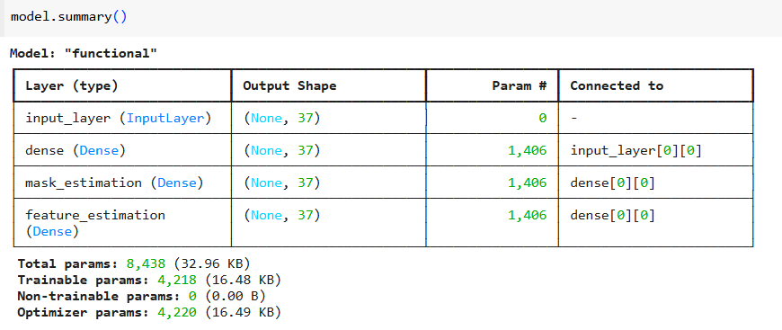
Model Architecture and Implementation
Semi-Supervised Learning:
Self-supervised encoder for feature extraction
Supervised fine-tuning with logistic regression and XGBoost
Training Details:
Batch size, epochs, optimizers
Handling label imbalance with class weights

Slide 7
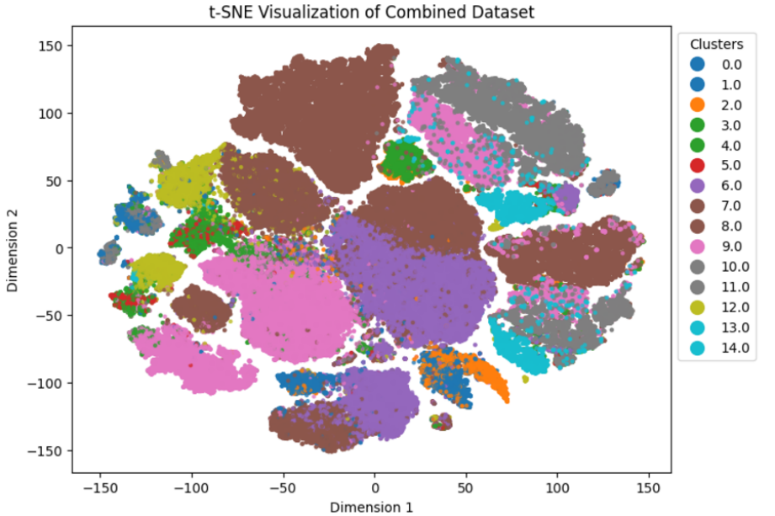
Results and Evaluation
Quantitative Metrics:
Logistic Regression Log Loss: 0.0649
XGBoost Log Loss: 0.0073
Self-Supervised Model Accuracy: 93.54%, AUROC: 99.09%
Visual Insights:
t-SNE plot showcasing cluster separation
TSNE After Encoder Implementation

Slide 8
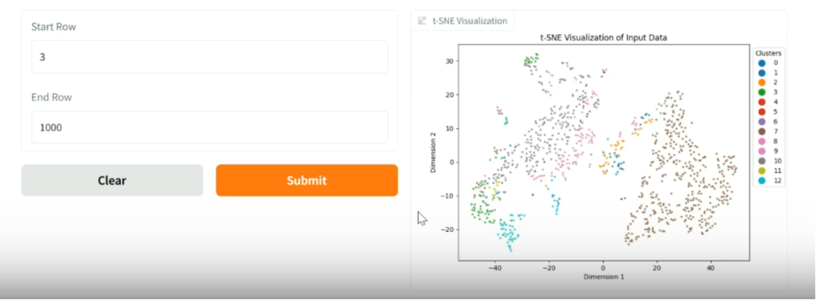
Gradio Interface for User Interaction
Features:
Visualize data subsets with t-SNE
Predict cell types dynamically
Key Functions:
Encodes unlabeled data
Generates predictions and visualizations
Implementation Demo link:
https://www.loom.com/share/2f2860854bc4432782f21f0d5a2f412e?sid=6caf1aaf-7012-4e7a-8686-17867349d4ee

Slide 9
THANK YOU
J.MOHAN KUMARI

